Slide 1

ENRON EMAIL DATASET
By,
Sakthi Gokul G
Senior Analyst

Slide 2
File Description:
File extension is in tar.gz.
After extracting the file it contains 8 folders as 1 to 8.
Each folder contains .txt file and .cats file.

Slide 3
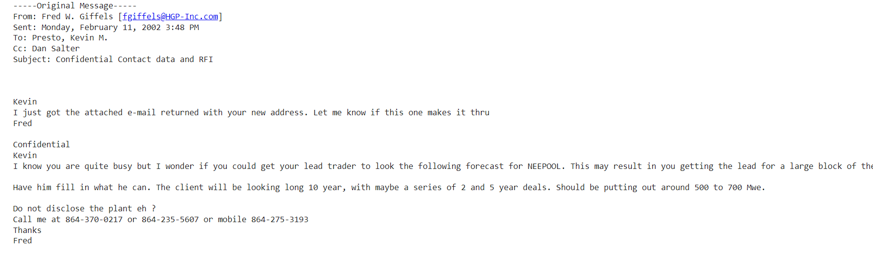
.txt files – Having Emails take it as features

Slide 4
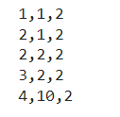
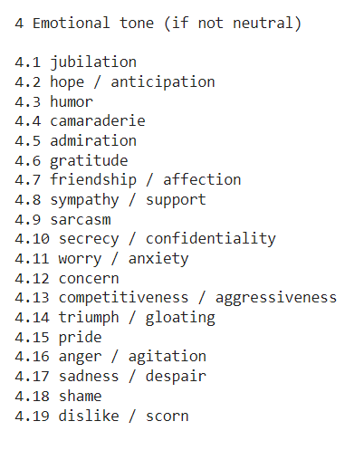
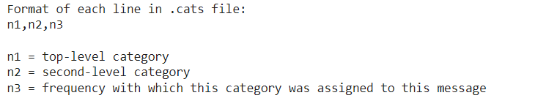
.cats file – Having multiple labels respective to each email text file.
Label representation.
Labels in the form of
So, we need to extract n1 and n2 from this .cats file for all the emails.
We can exclude the frequency.

Slide 5
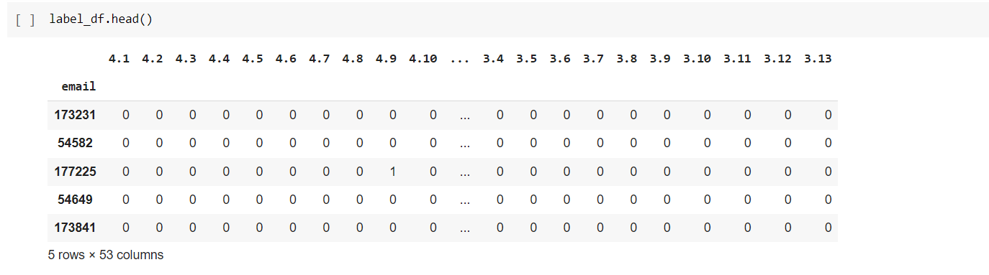
Extracting Label- 53 labels as Y
Individually for Every Top level category(n1)- 1,2,3,4.
Finally merged every category.

Slide 6
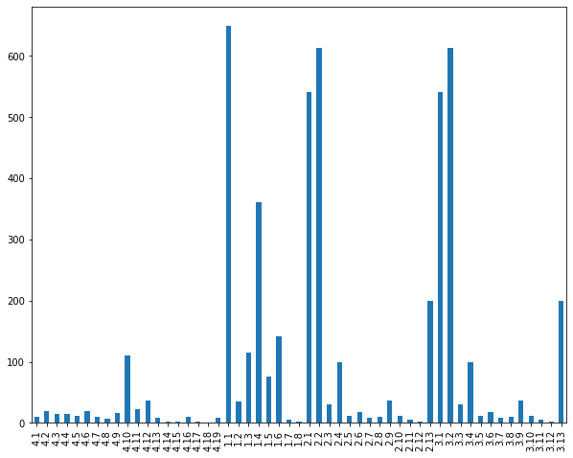
Label Distribution on Email

Slide 7
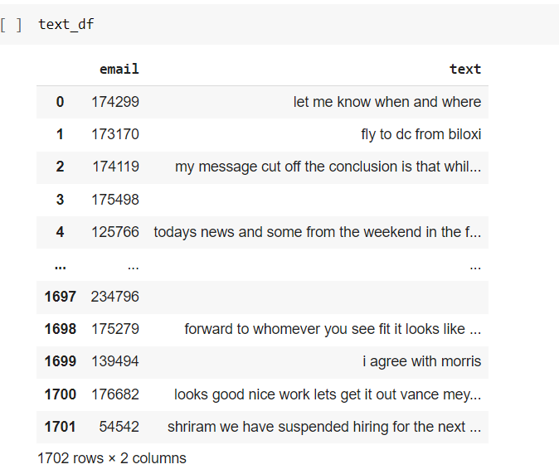
Extracting Email Text- 1702 rows Text as X

Slide 8
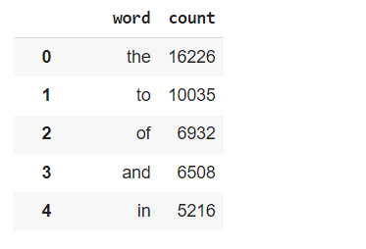
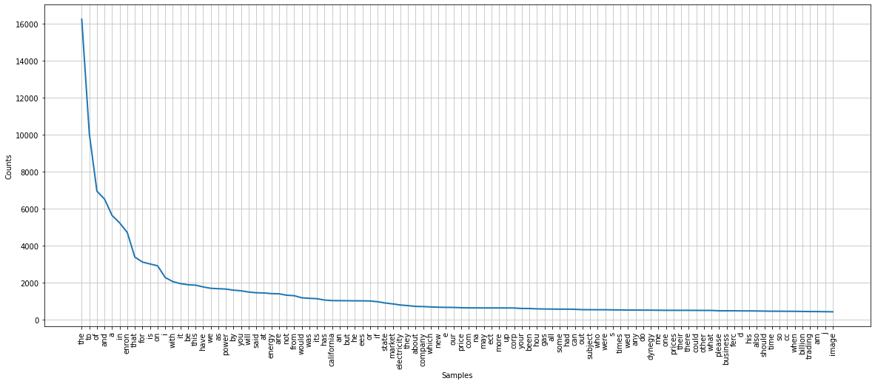
Feature Engineering – Cleaning Email text

Slide 9
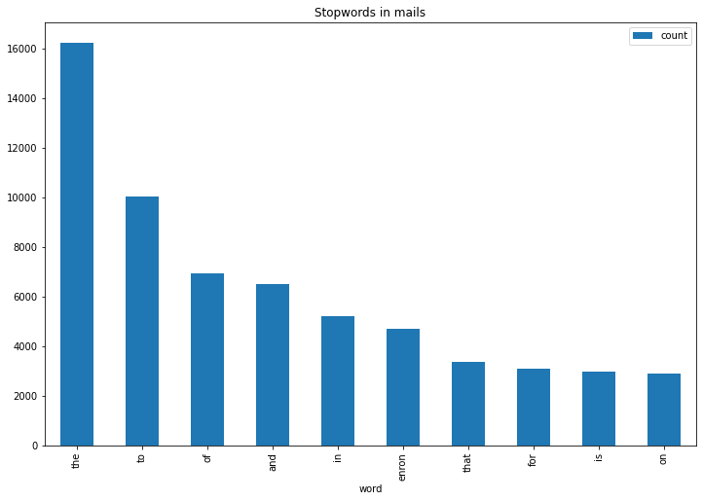
Stopwords
There are so many stopwords in the text we need to remove them

Slide 10
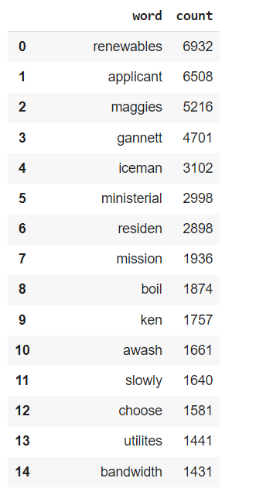
After removing Stopwords some individual words repeated in all emails we need to remove them.
Removed the words that had a count value of around 1000.

Slide 11

Wordcloud view – After cleaning

Slide 12
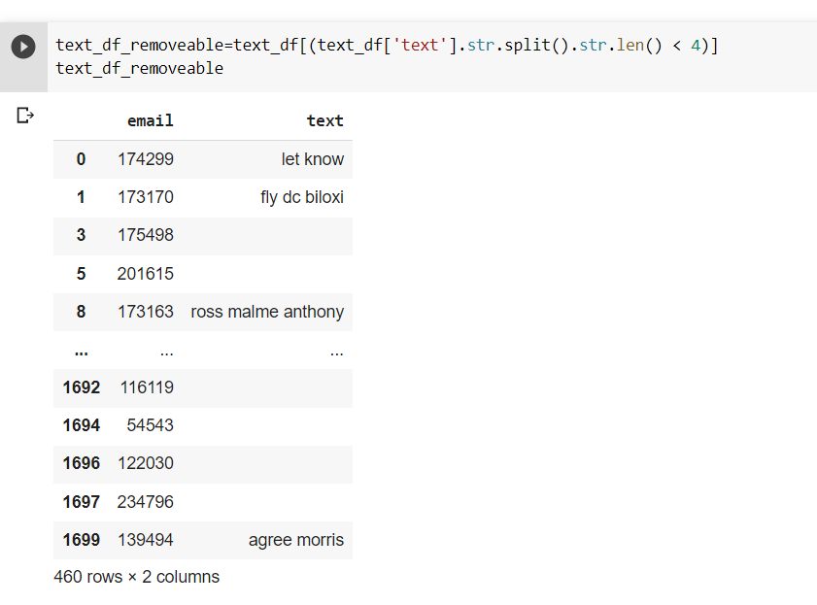
After cleaning the text – Decide to remove the rows having null values and less than 4 words that will affect the accuracy.(460 rows)

Slide 13
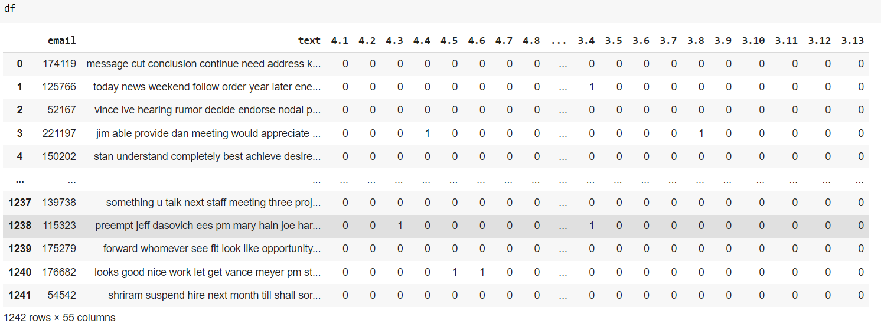
Final Dataset – 1242 rows and 55 columns
Saving this data frame to CSV.

Slide 14
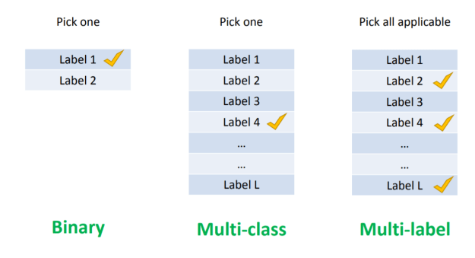
Multi-Label Classification
Each email has multiple labels so it is a multilabel classification problem.

Slide 15
Machine learning Model – Scikit Multilearn
Fitting Text column(X) with Tfidf.
Using a combination of multilabel packages with a normal Algorithm.
Using a combination of multiclass and Pipeline with a normal Algorithm.
Machine Learning Algorithm | Multilabel Transformer | Accuracy Score
Multinomial Naïve Bayes | BinaryRelevance | 11%
Multinomial Naïve Bayes | ClassifierChain | 7%
Multinomial Naïve Bayes | Label Powerset | 20%
Machine Learning Algorithm | Multiclass | Accuracy Score
Multinomial NB | OneVsRestClassifer | 14%
Linear SVC | OneVsRestClassifer | 22%
Logistic Regression | OneVsRestClassifer | 24%

Slide 16
Deep Learning Model
Model using LSTM and Bidirectional LSTM.
Model Name | Embedding File | Accuracy Score
LSTM | glove.6B.100d.txt | 38%
BiLSTM | glove.6B.100d.txt | 41%
BiLSTM | glove.840B.300d.txt | 36%

Slide 17
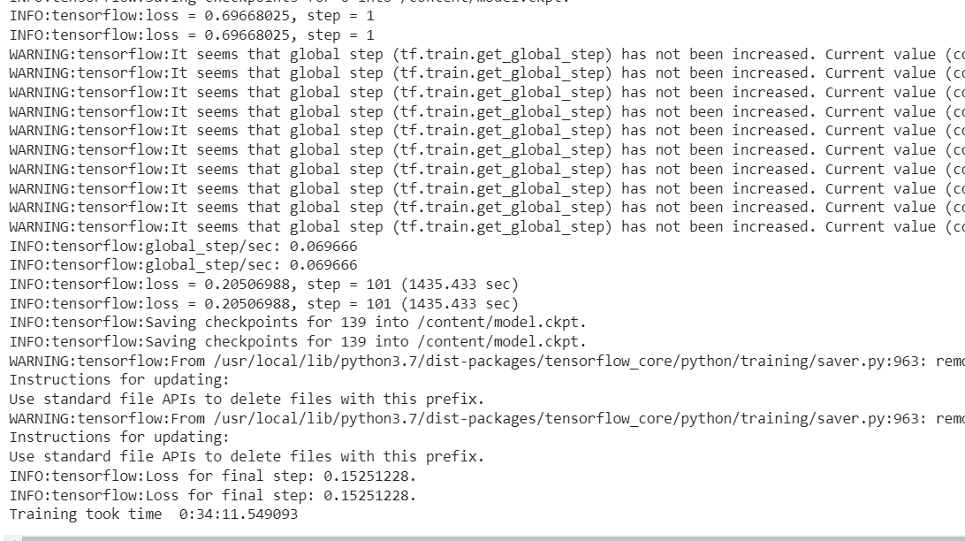
Some other models I tried- were BERT, RNN, and CNN.

Slide 18


